Slide 1





Slide 2


Meet Our Team
Moaz Waheed Ramadan
Ahmed Abd-Elrahiem Mohamed
Amr Fatouh Abass
Khadija Mohamed Kord
Mohamed Ahmed Mohamed

Slide 3






INTRODUCTION
Telecom Company
Churn Customers
Best Solutions

Slide 4
Introduction
Database Design
Content
DWH Design
ETL Process
Analyzing data

Slide 5

01
Data Collection
02
Understanding the data
Database Design
03
Data Cleaning
Collecting and understanding data ensures a clear foundation. Cleaning enhances accuracy, and an ERD organizes the structure. Creating SQL tables and transferring data supports efficient analysis and decision-making.
04
Design entity relation diagram ( ERD )
05
Modeling and Mapping
06
Creating Data Base Using SQL
07
Transferring the data into SQL

Slide 6

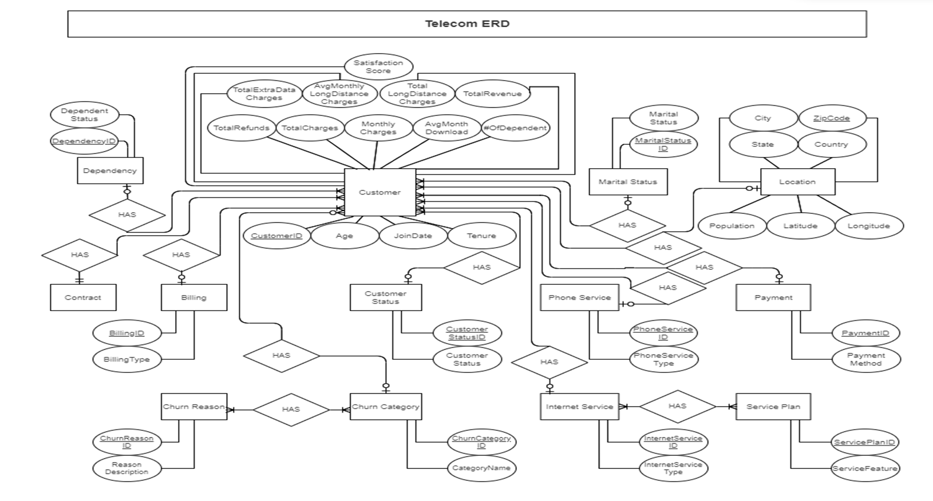
ERD

Slide 7

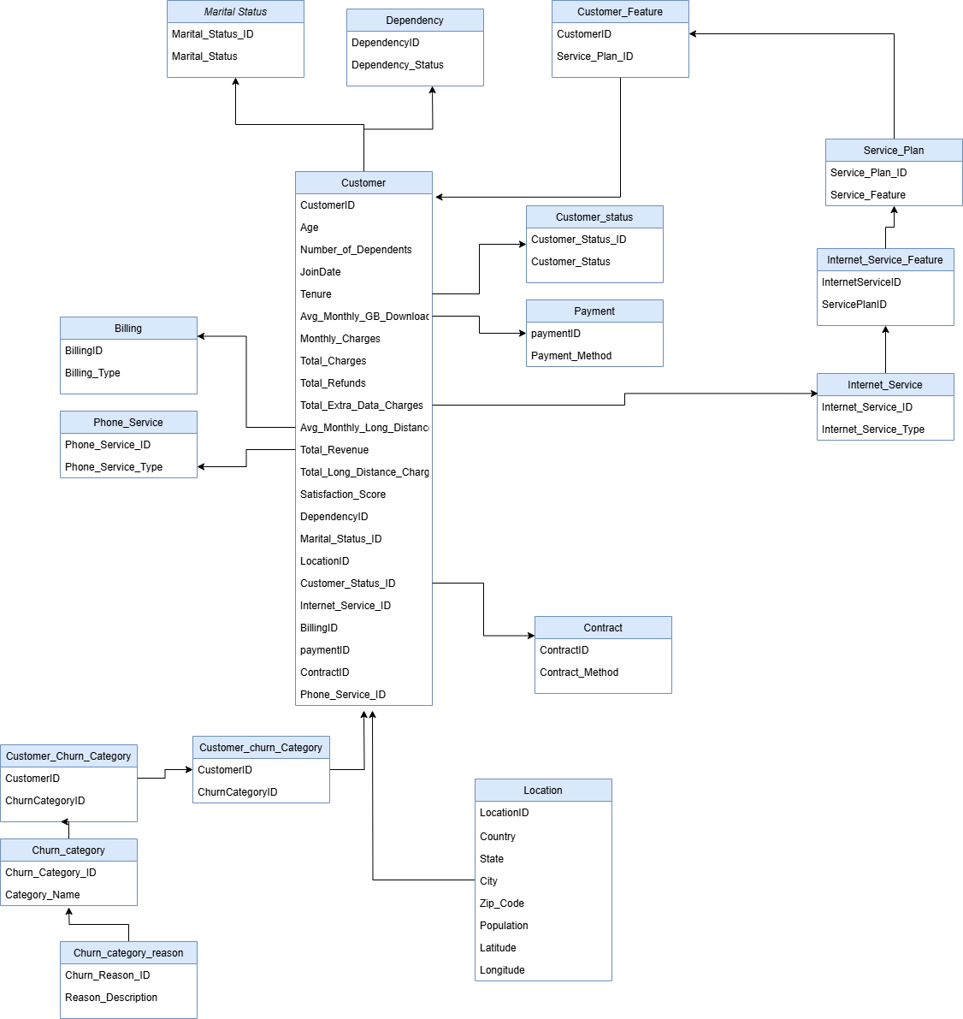
Mapping

Slide 8
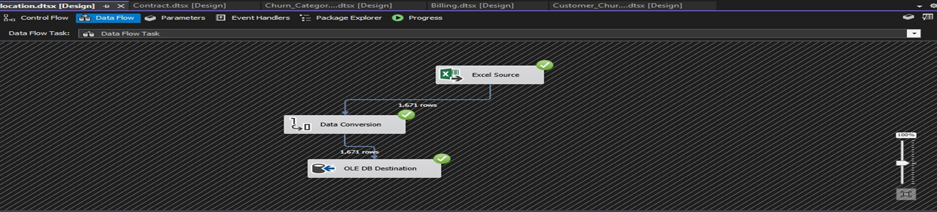
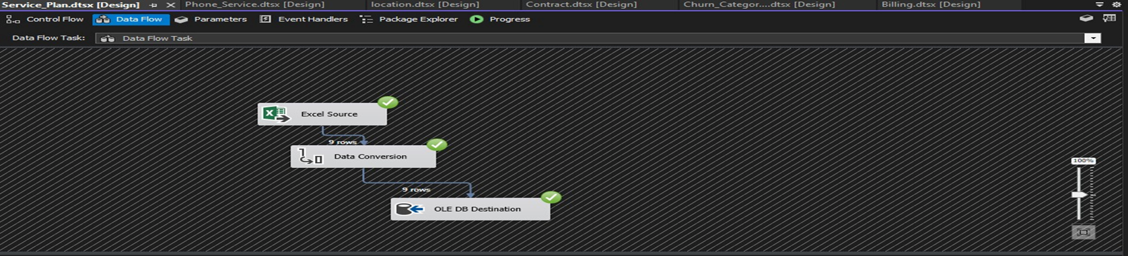
Transfer data to SQL

Slide 9
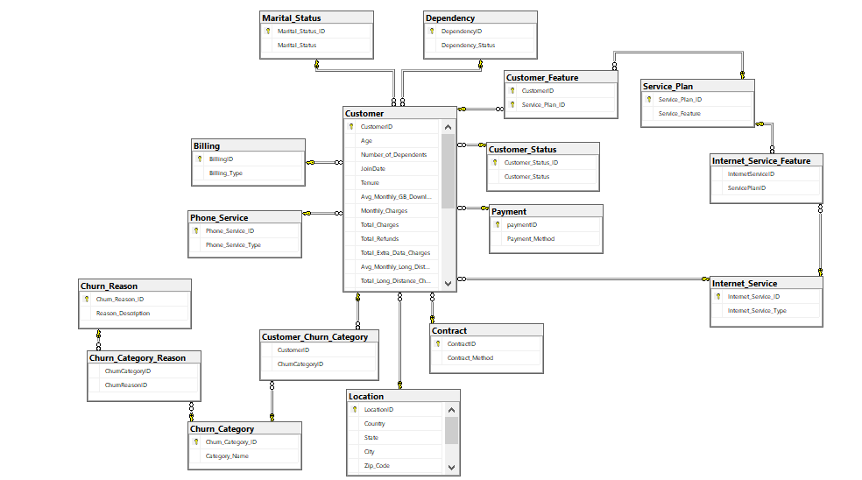
Database Diagram

Slide 10
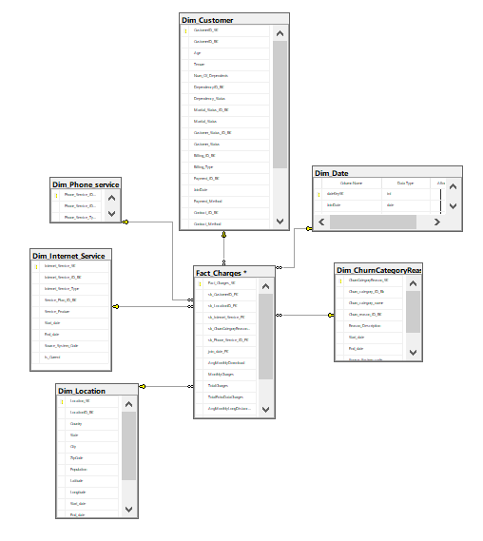
DWH Diagram

Slide 11
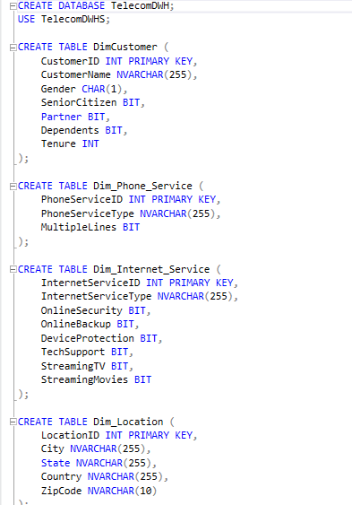
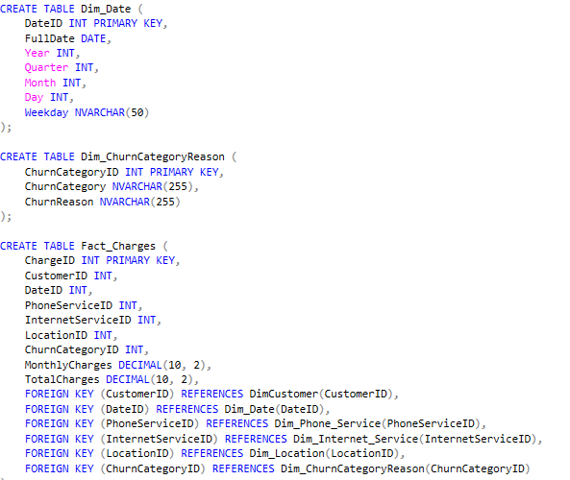
Creating DWH using SQL

Slide 12







ETL Process Overview
To facilitate the analysis of SK’s customer churn data, an ETL (Extract, Transform, Load) process was implemented. This process transforms the data from Data Base into a structured SQL Server Data Warehouse (DWH). The following tables were created in the DWH to organize the data effectively:
Date
Customer
Fact
category
Location
Internet_Service
Phone_Service

Slide 13
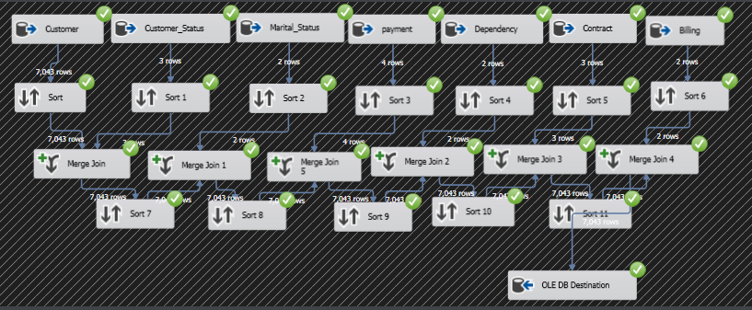
ETL Process

Slide 14
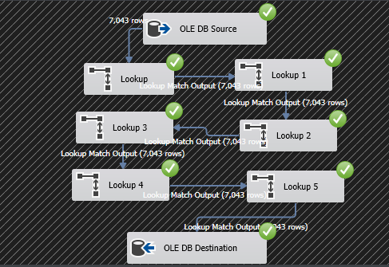
ETL Process

Slide 15

ANALYZING DATA
inspects, cleans, transforms, and models data to extract insights and support decision-making

Slide 16






VISUALIZATION
We can analyze data in multiple ways, such as:
01
SSAS and SSRS
02
visualization using Power BI
03
visualization using Tableau
04
visualization using Excel

Slide 17


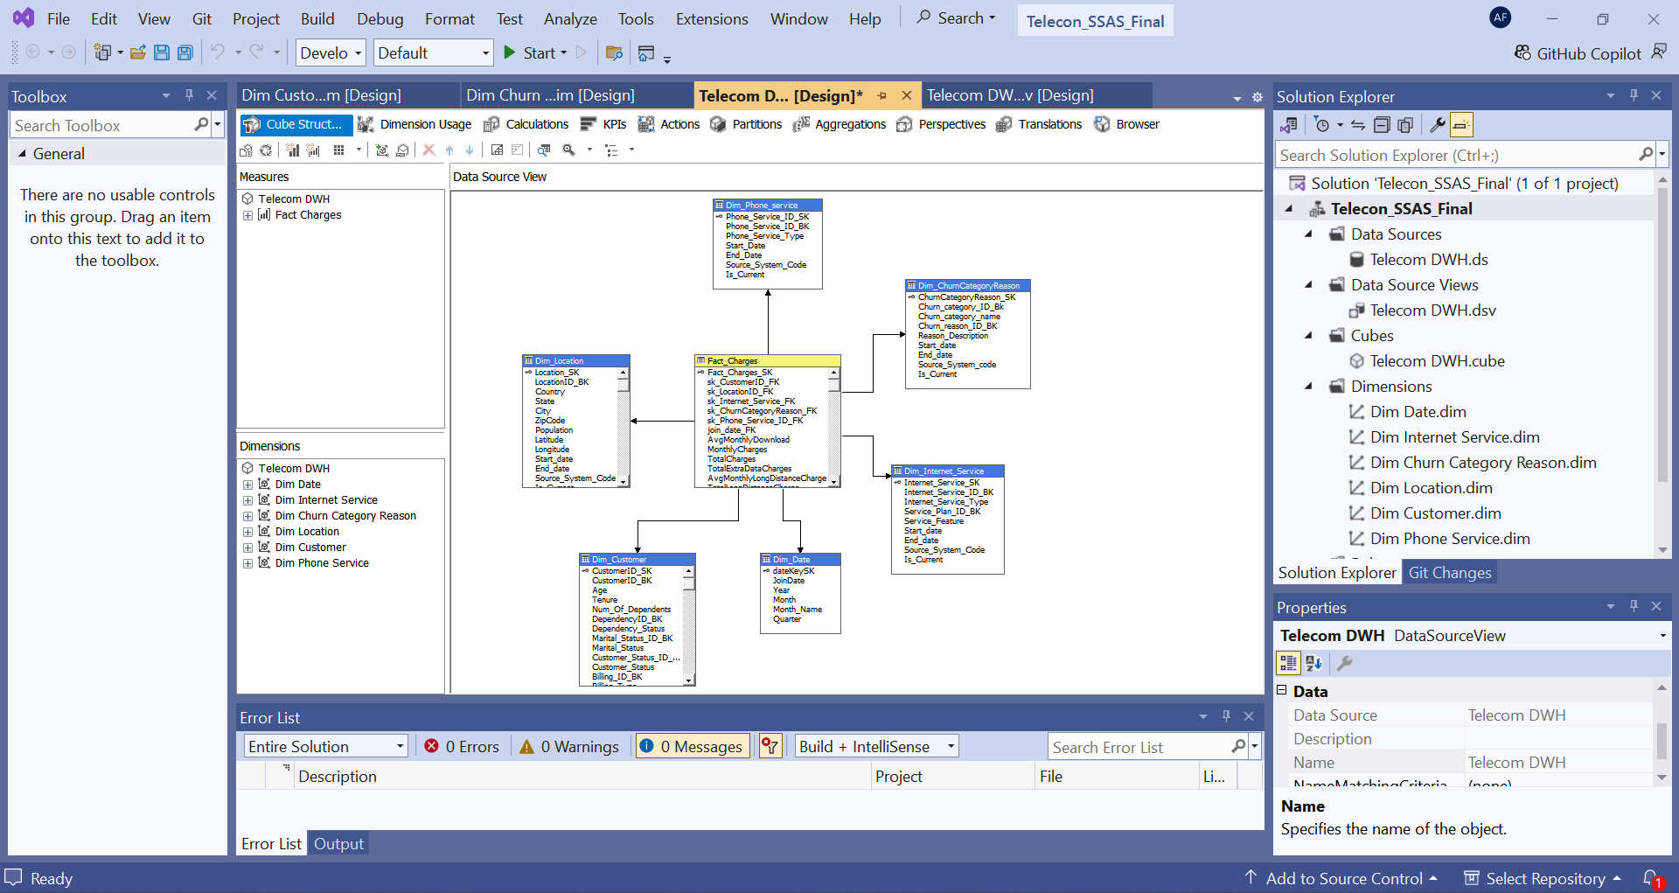
SSAS (CUBE STRUCTURE)

Slide 18
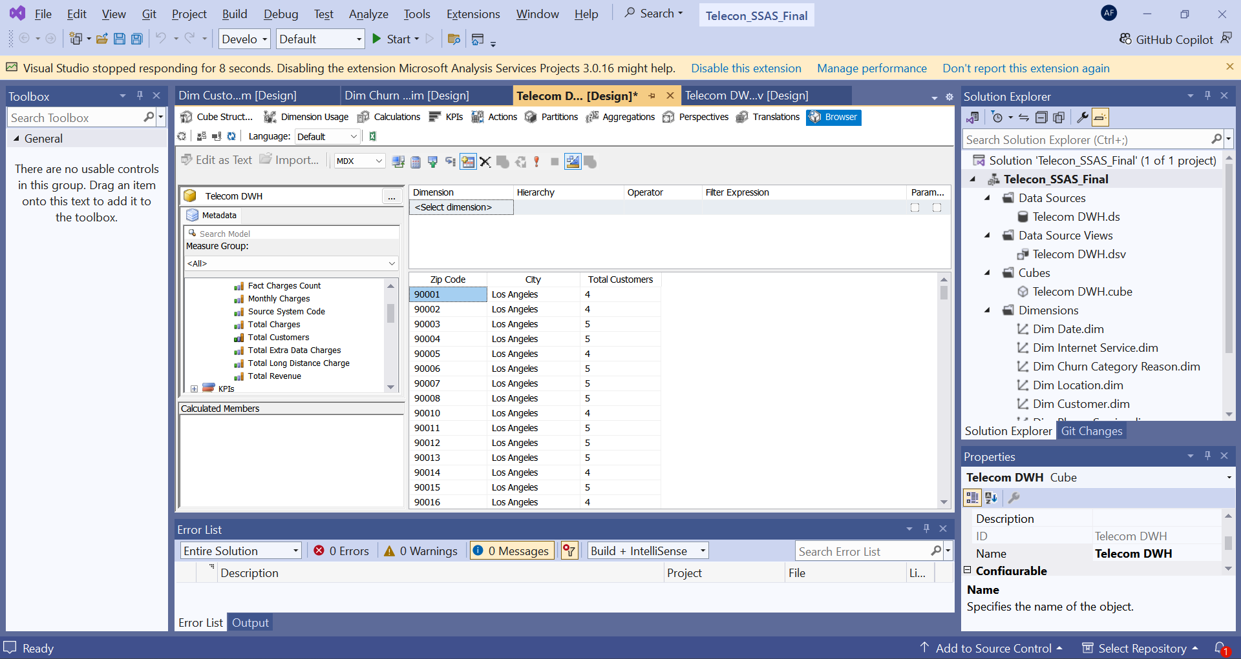
SSAS (CUBE BROWSER)

Slide 19
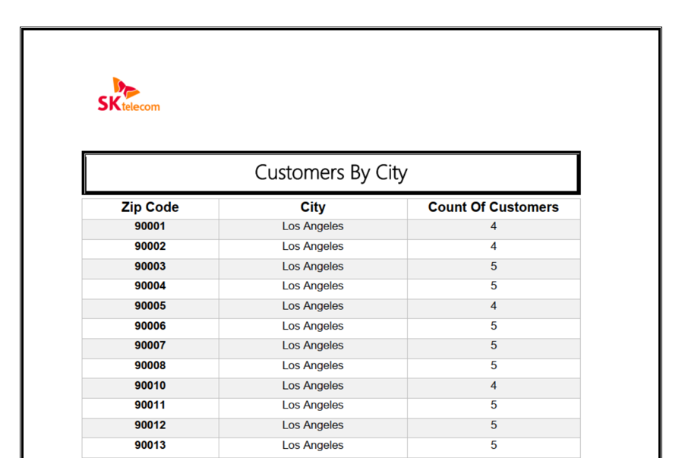
CUSTOMERS BY CITY
SSRS (Report)

Slide 20
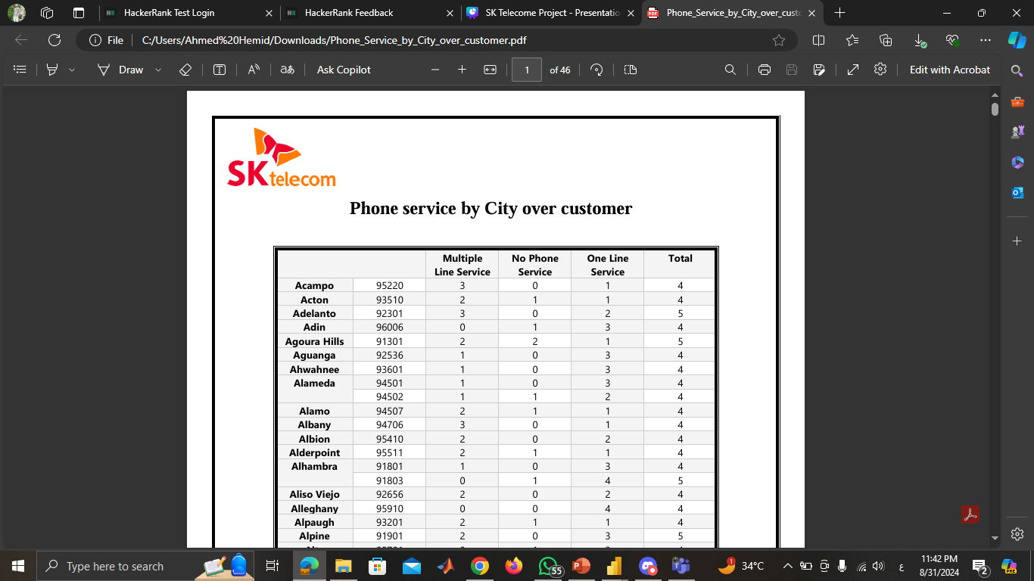
PHONE SERVICE BY CUSTOMER OVER EVERY CITY
SSRS - Report

Slide 21

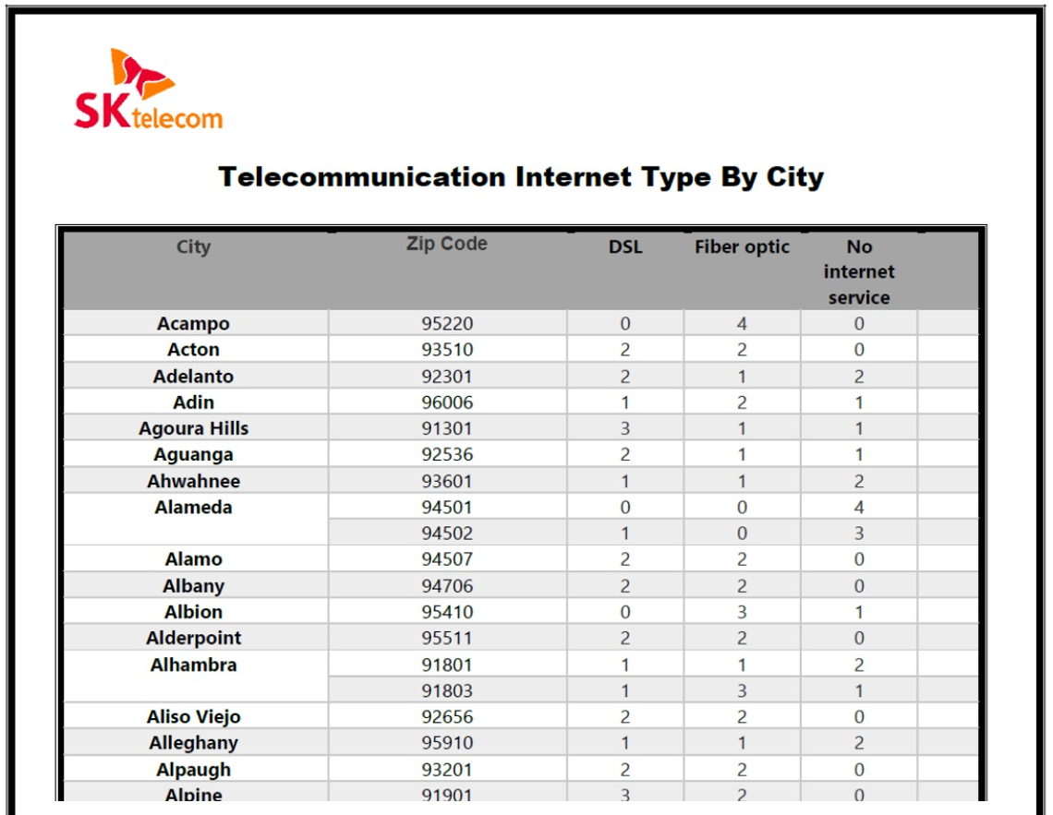
TELECOMUNICATION INTERNET TYPE BY CITY
SSRS (REPORT)

Slide 22
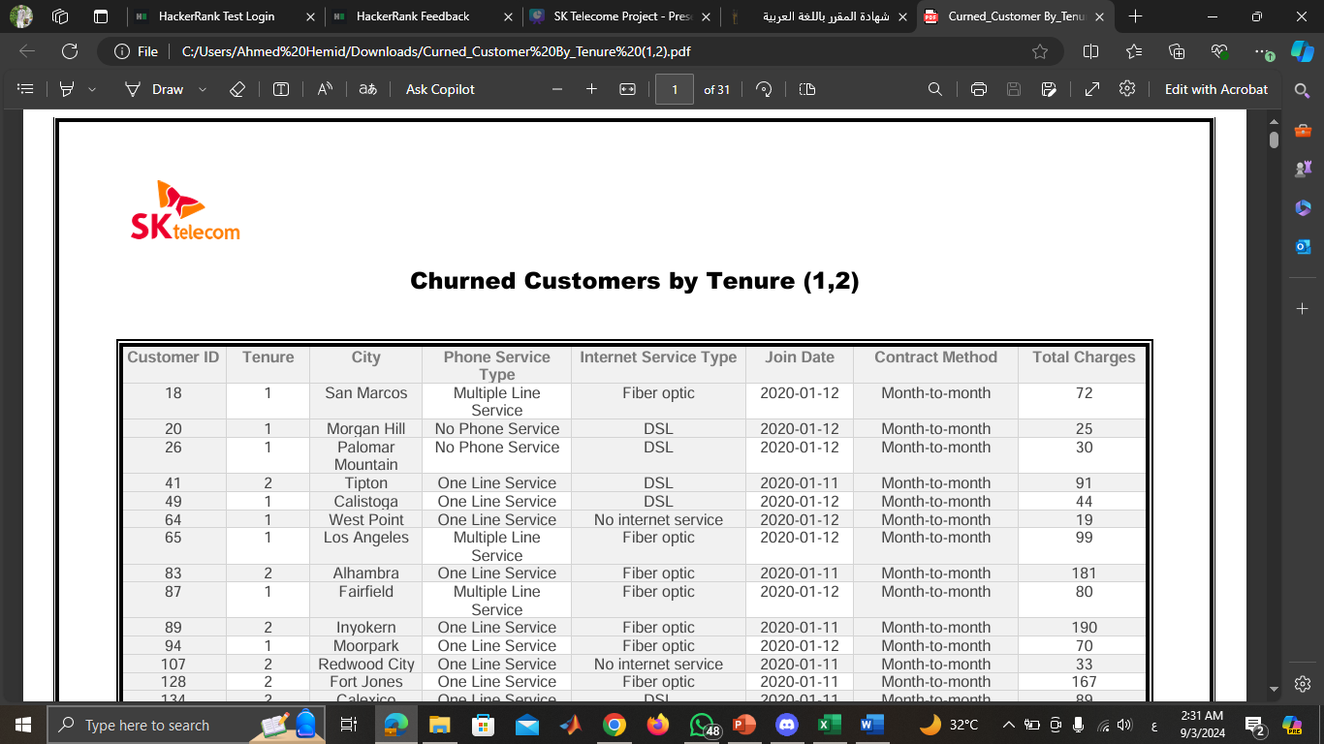
CHURNED CUSTOMERS BY TENURE(1,2)
SSRS (REPORT)

Slide 23

Power BI Analysis

Slide 24
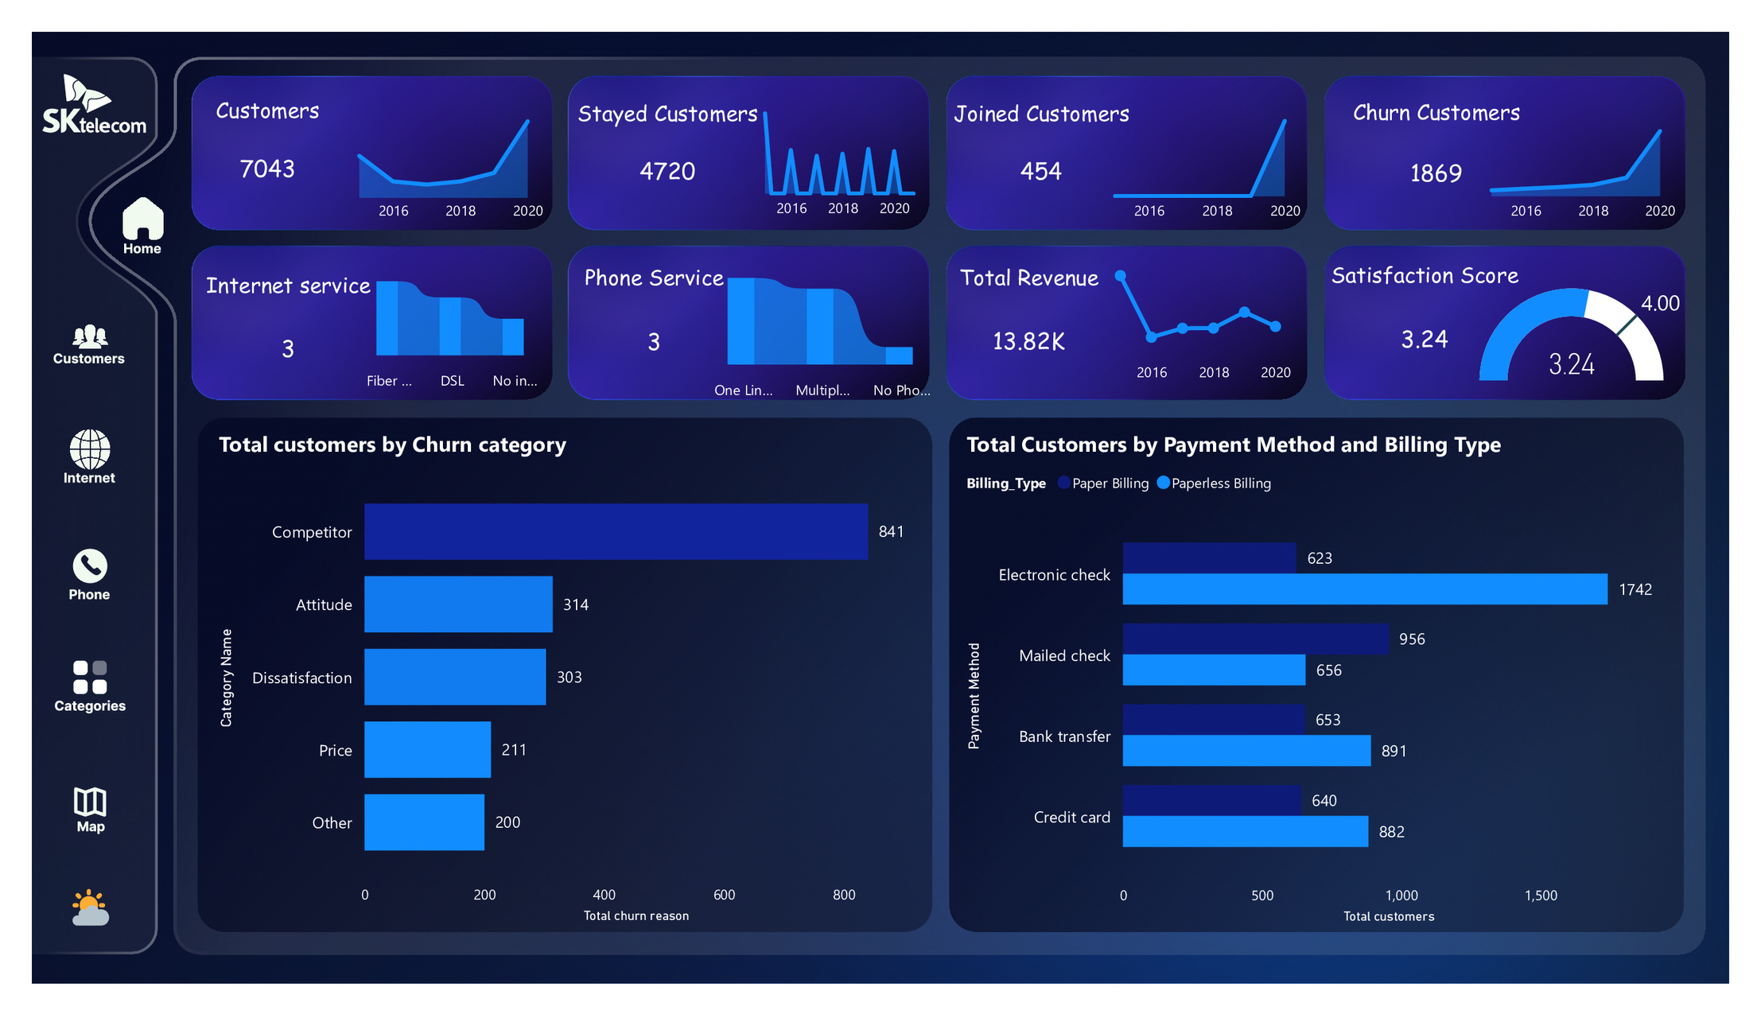
Overview (Dark Mode)

Slide 25
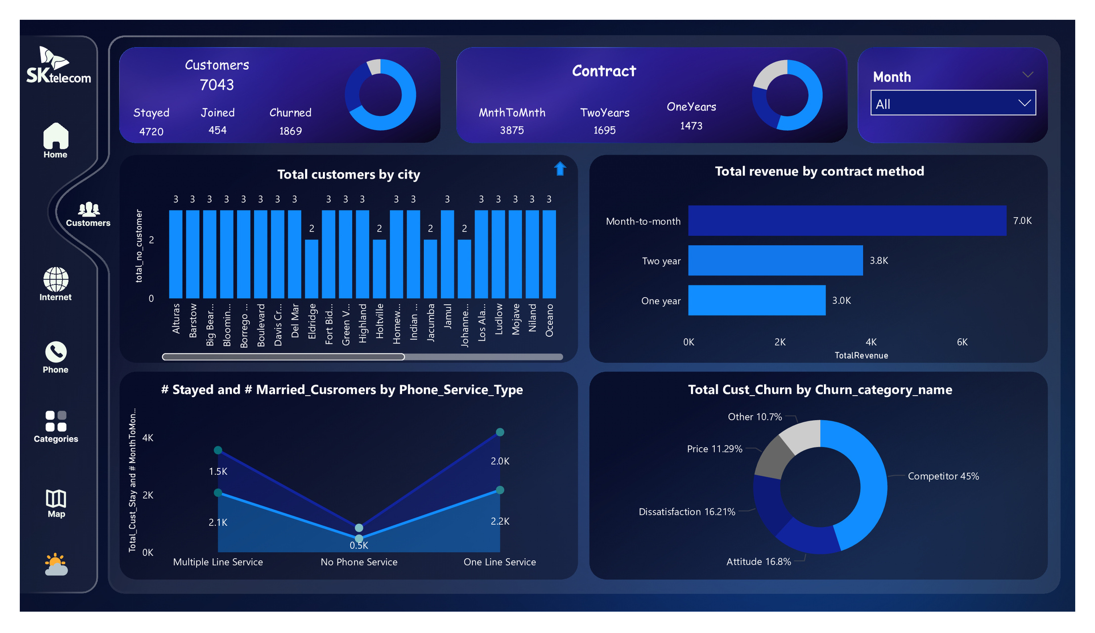
Customer (Dark Mode)

Slide 26
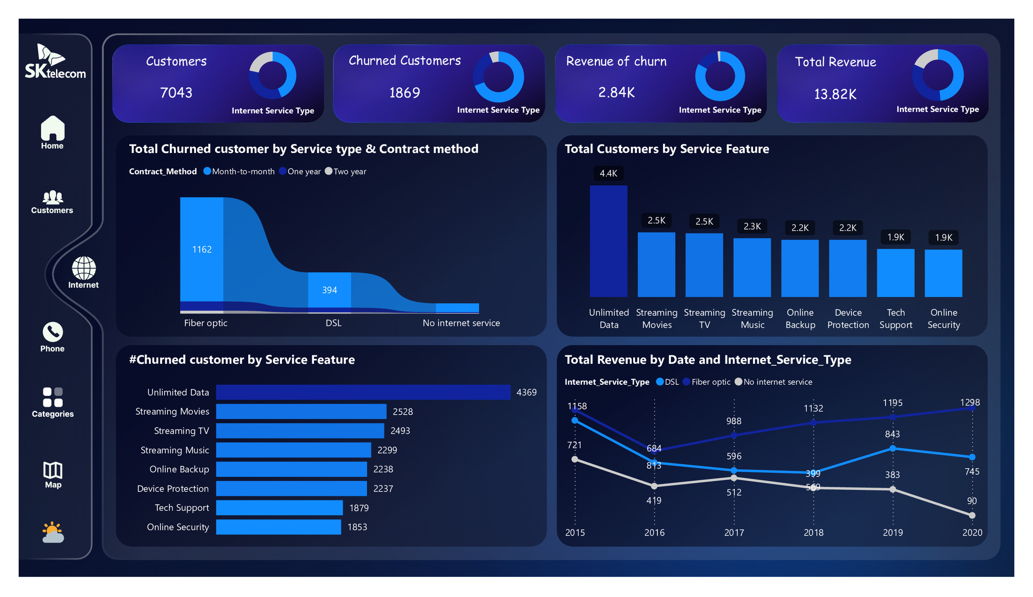
Internet Service (Dark Mode)

Slide 27
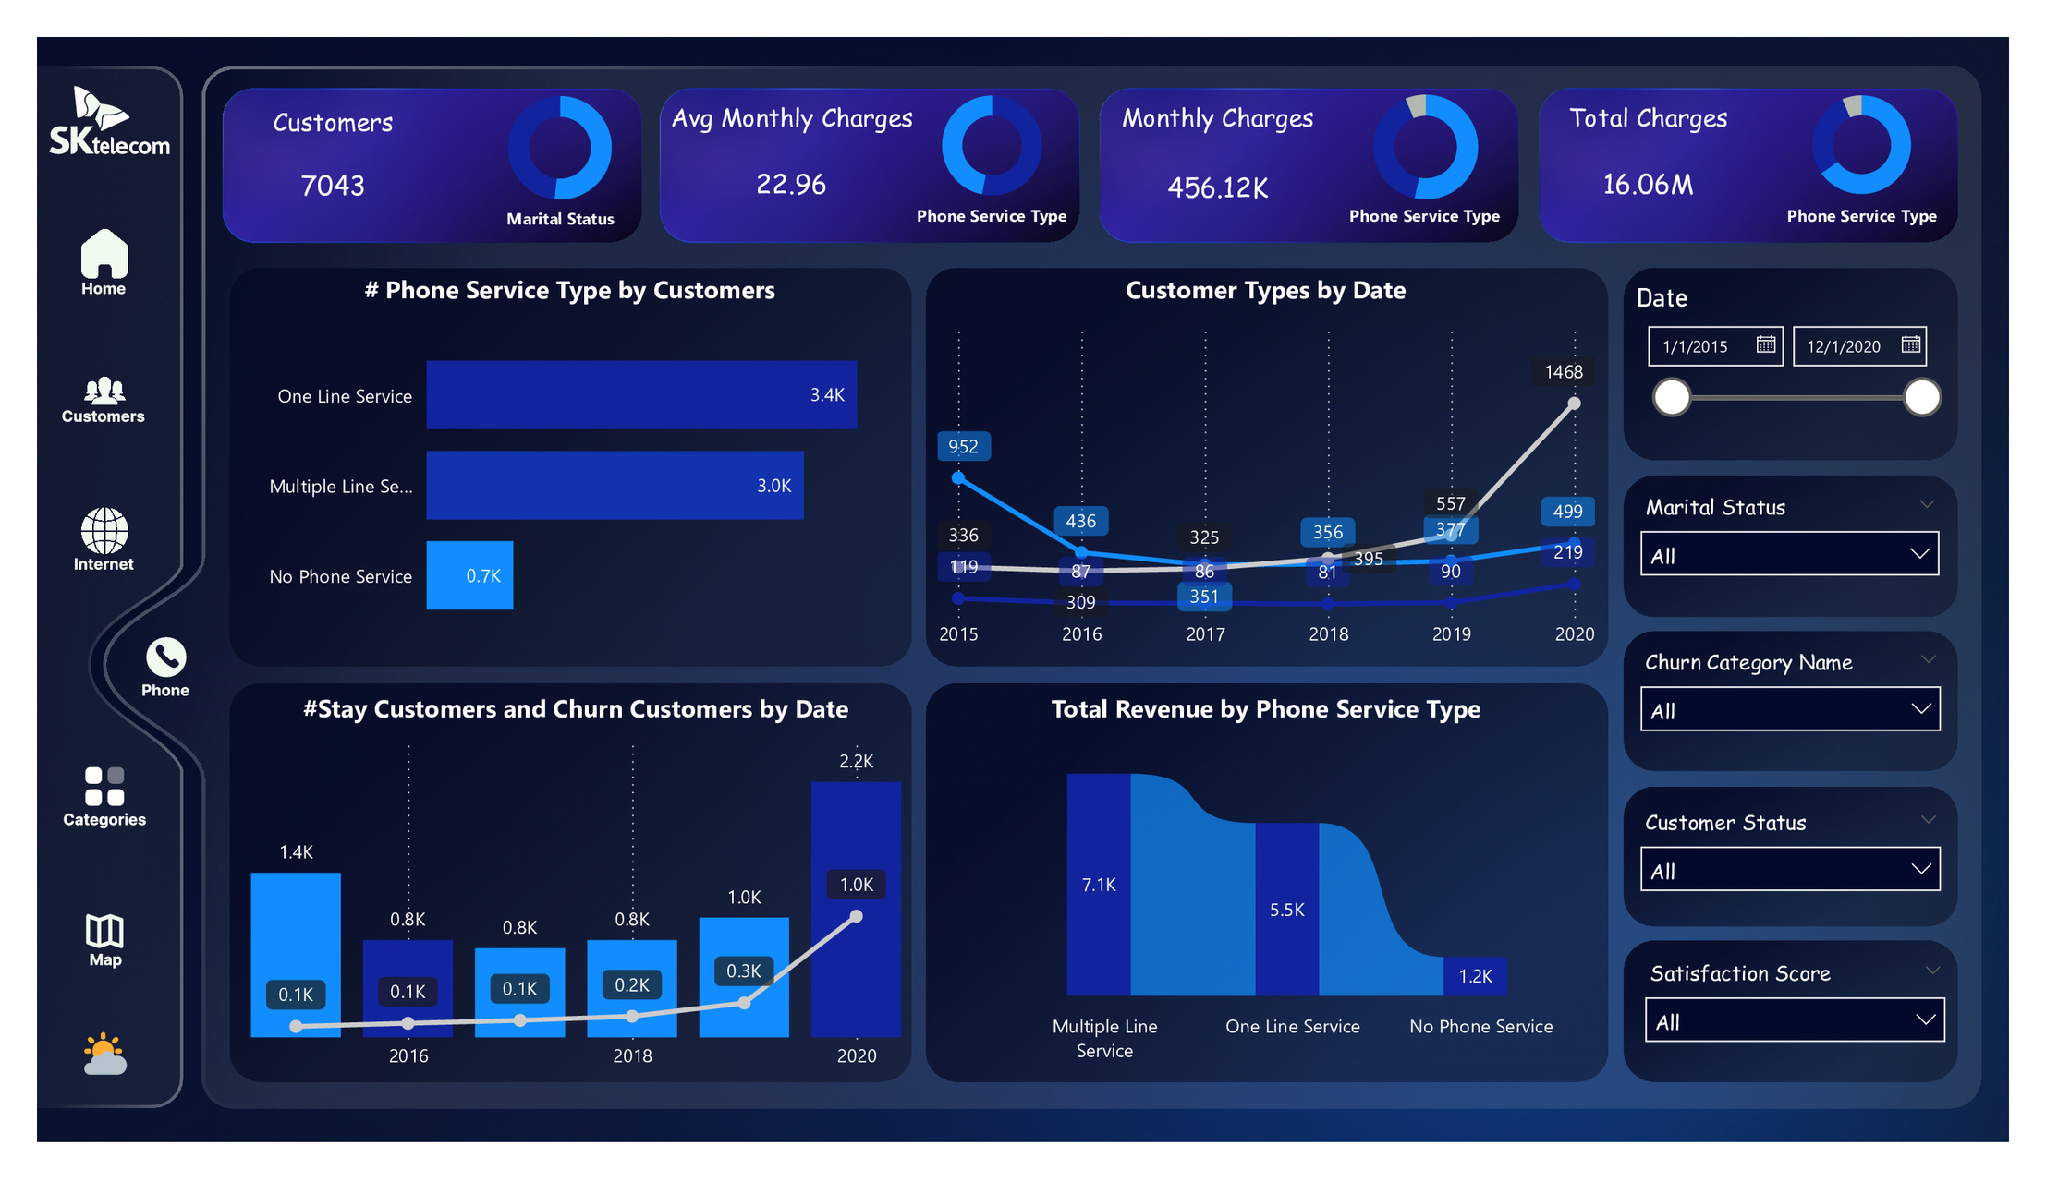
Phone Service (Dark Mode)

Slide 28
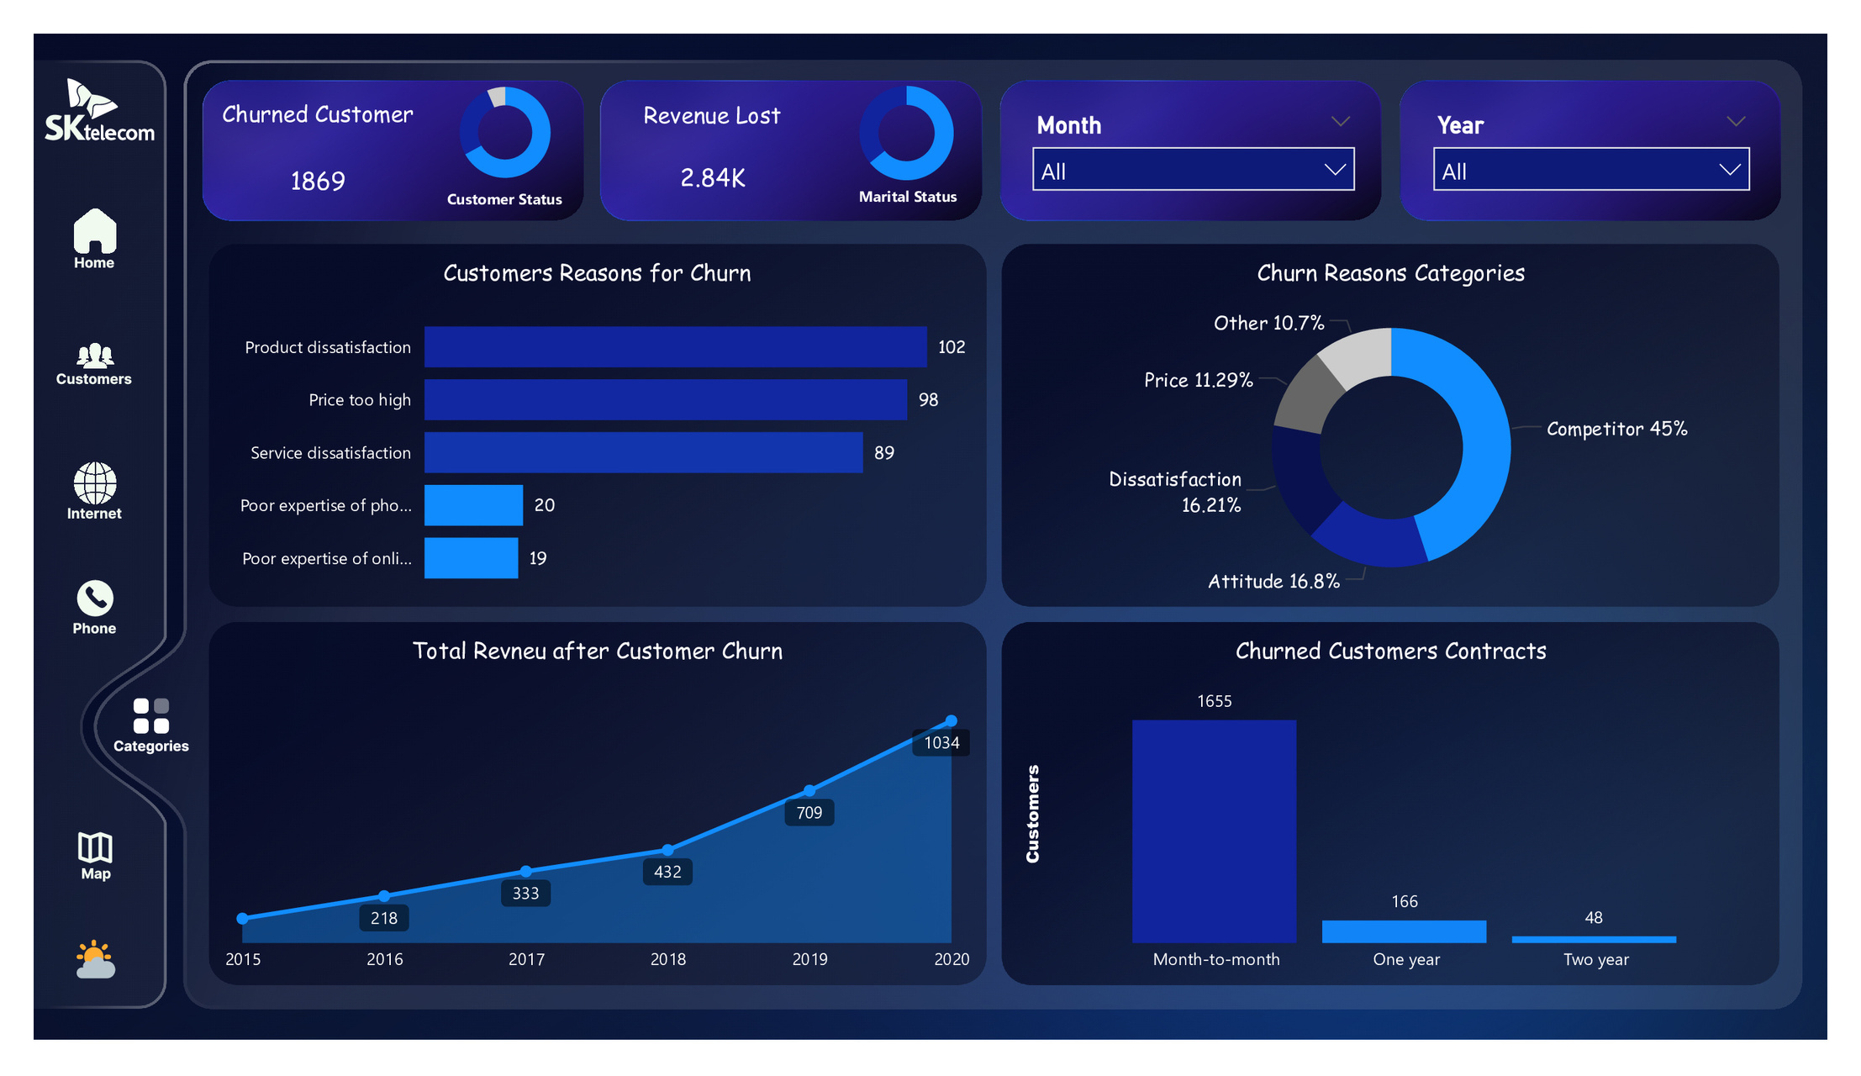
Category (Dark Mode)

Slide 29
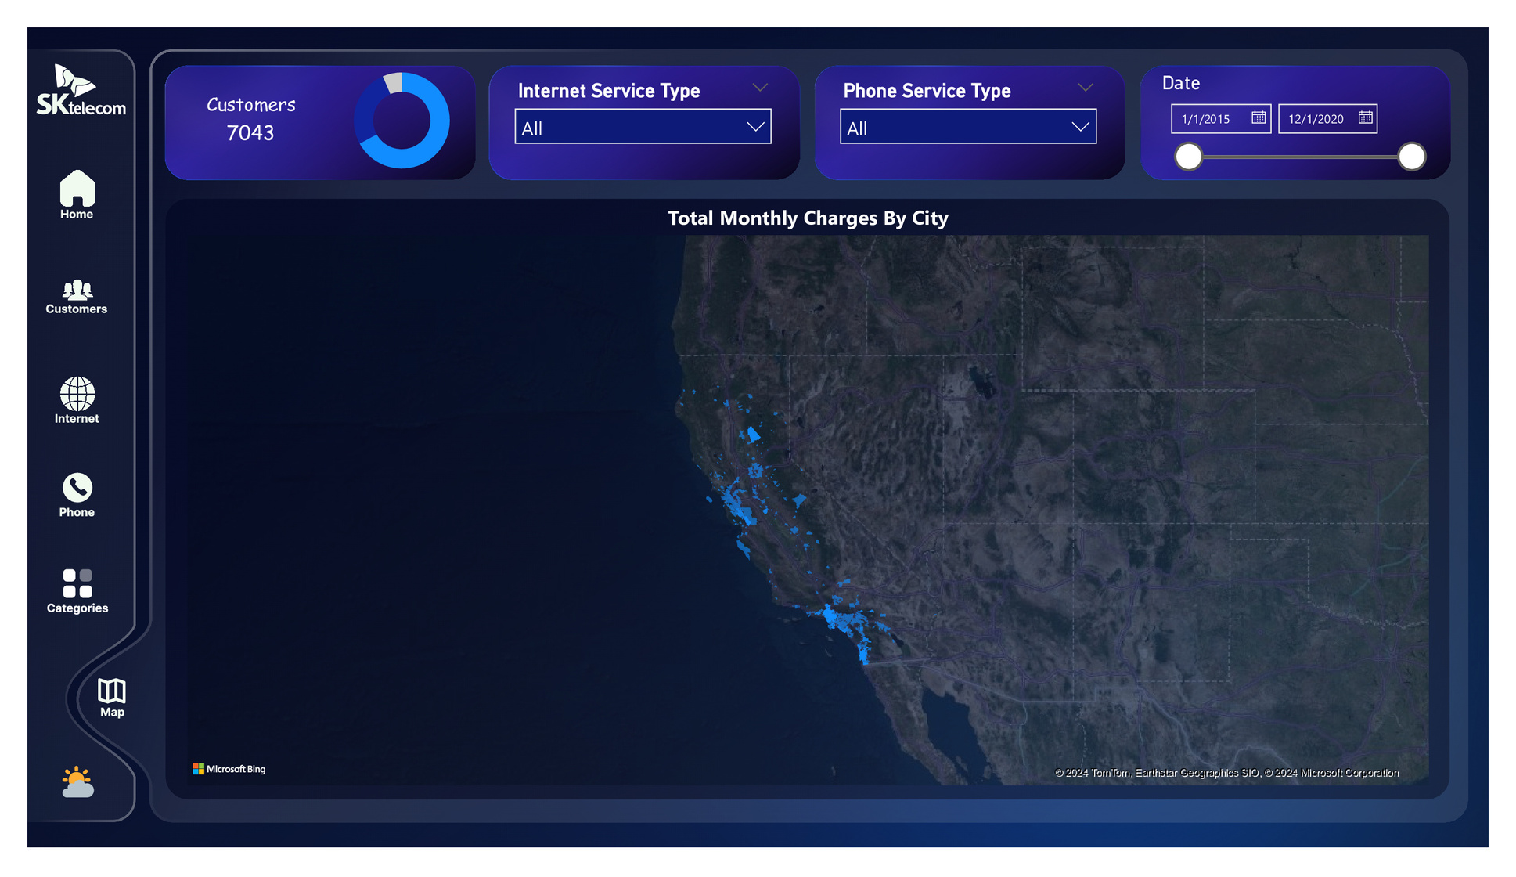
Map (Dark Mode)

Slide 30
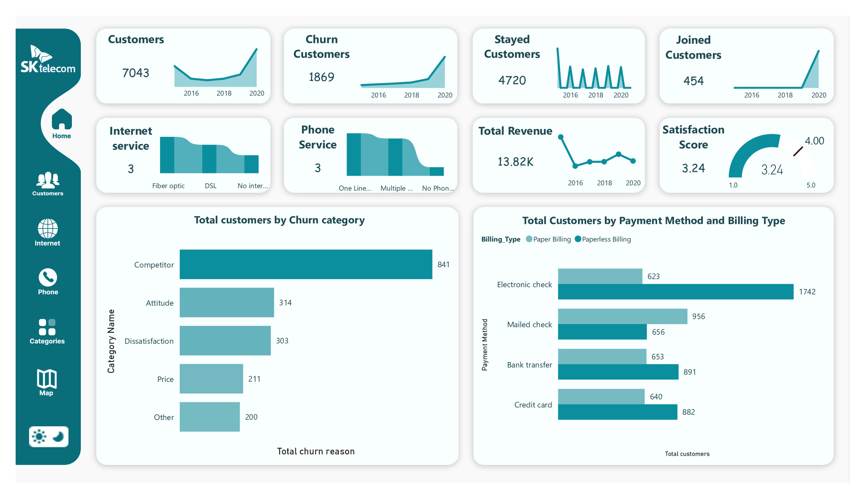
Overview (White Mode)

Slide 31
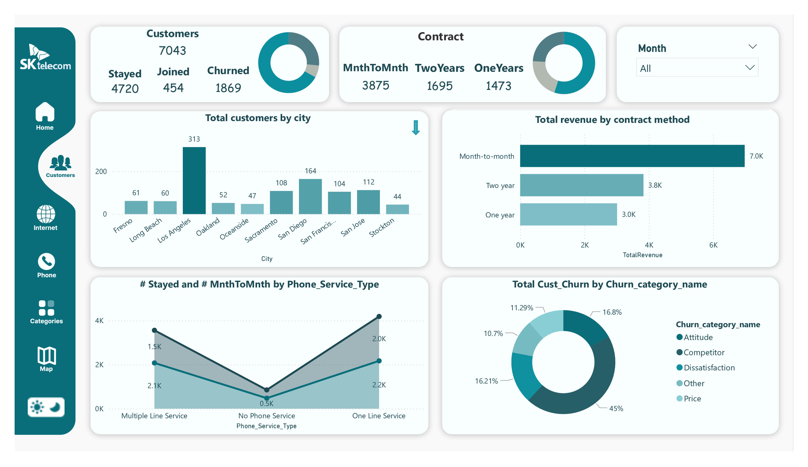
Customer (White Mode)

Slide 32
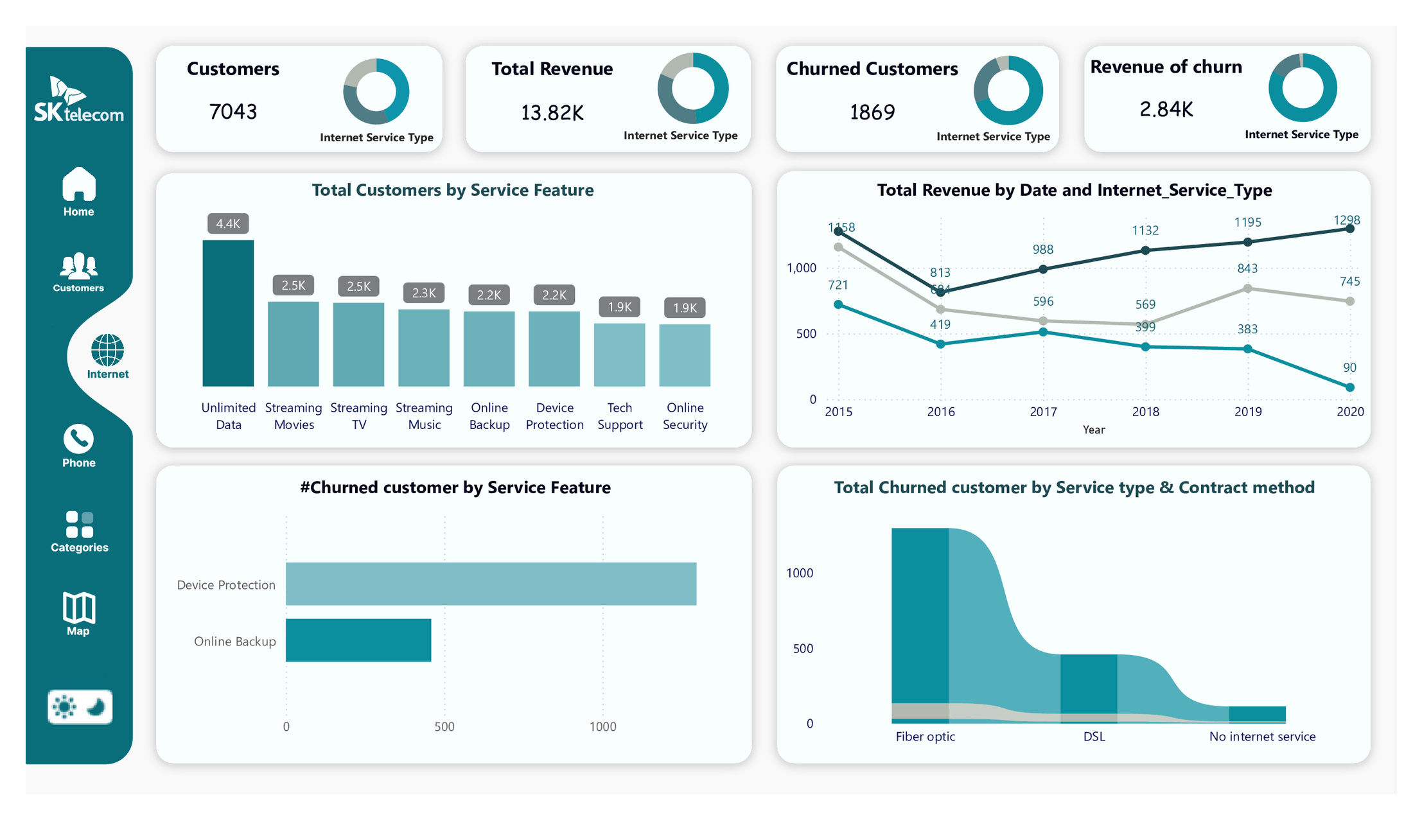
Internet Service (White Mode)

Slide 33
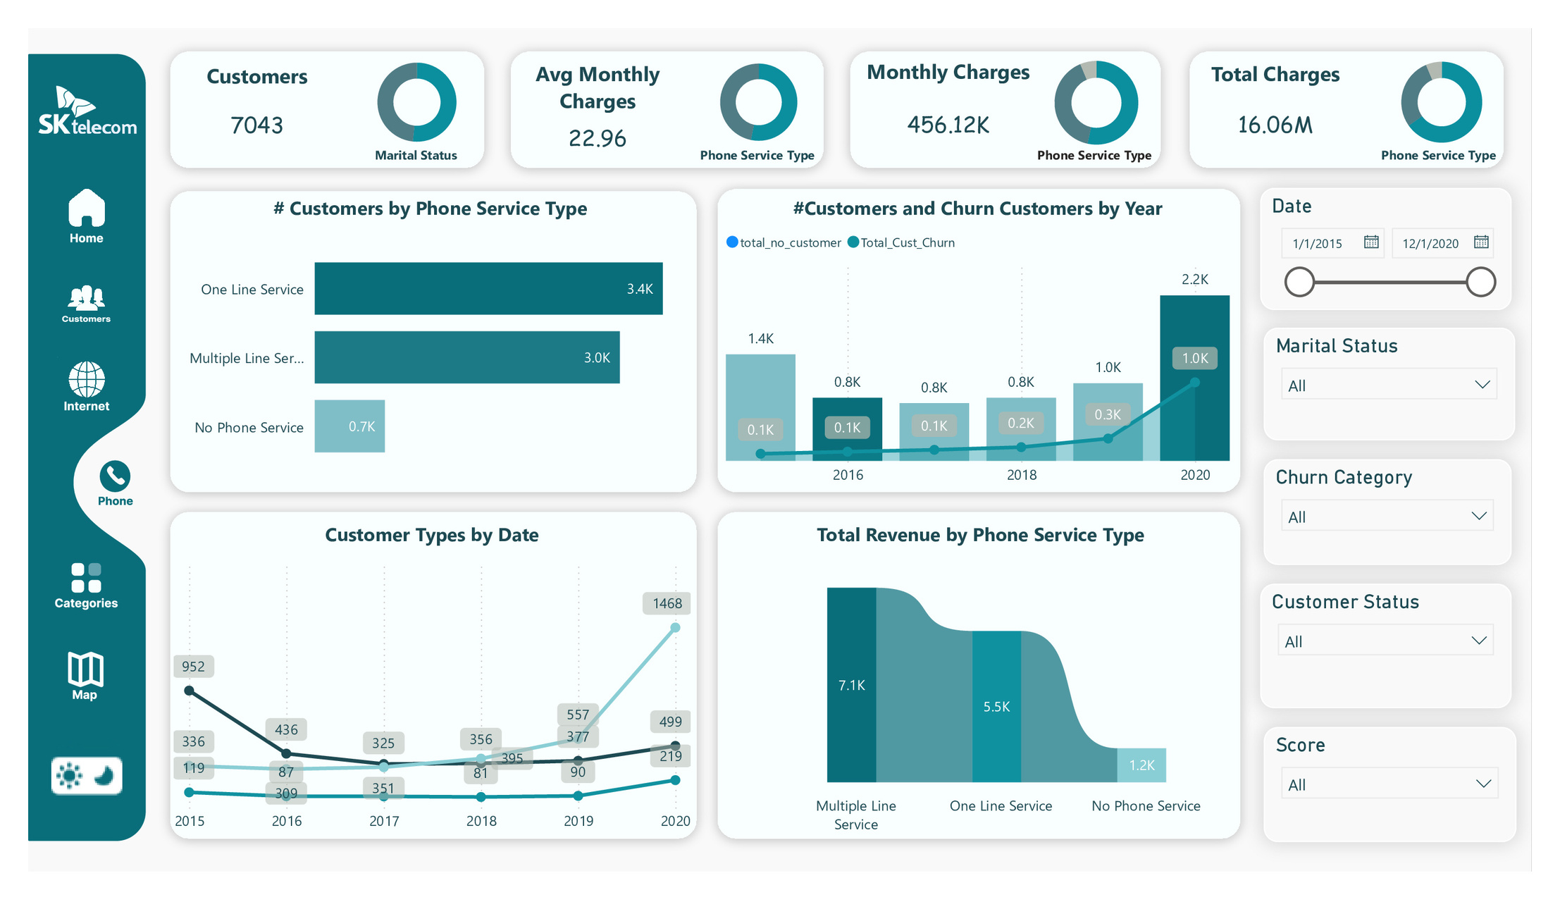
Phone Service (White Mode)

Slide 34
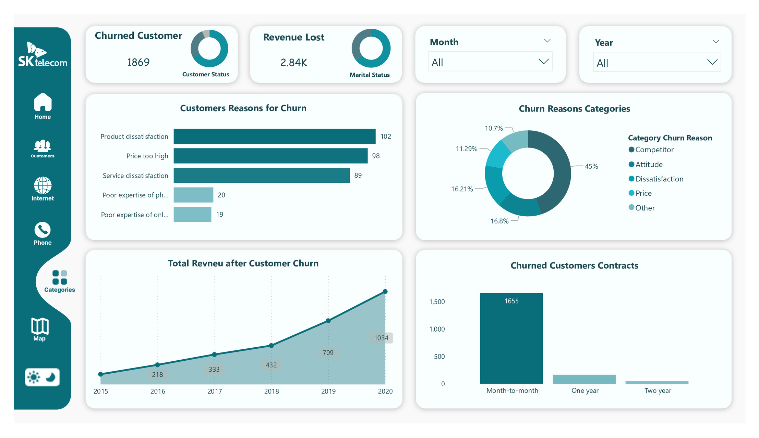
Category (White Mode)

Slide 35
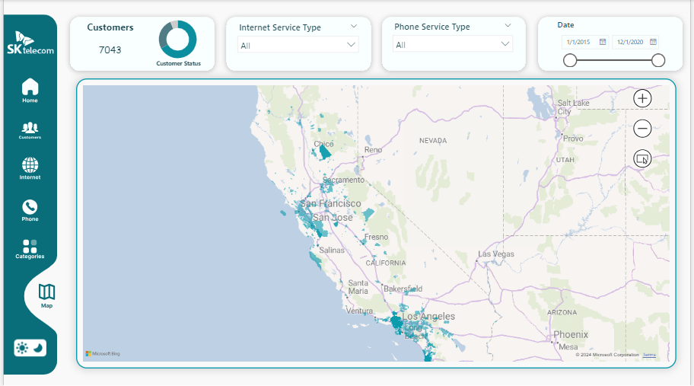
Map (White Mode)

Slide 36

Tableau Analysis

Slide 37
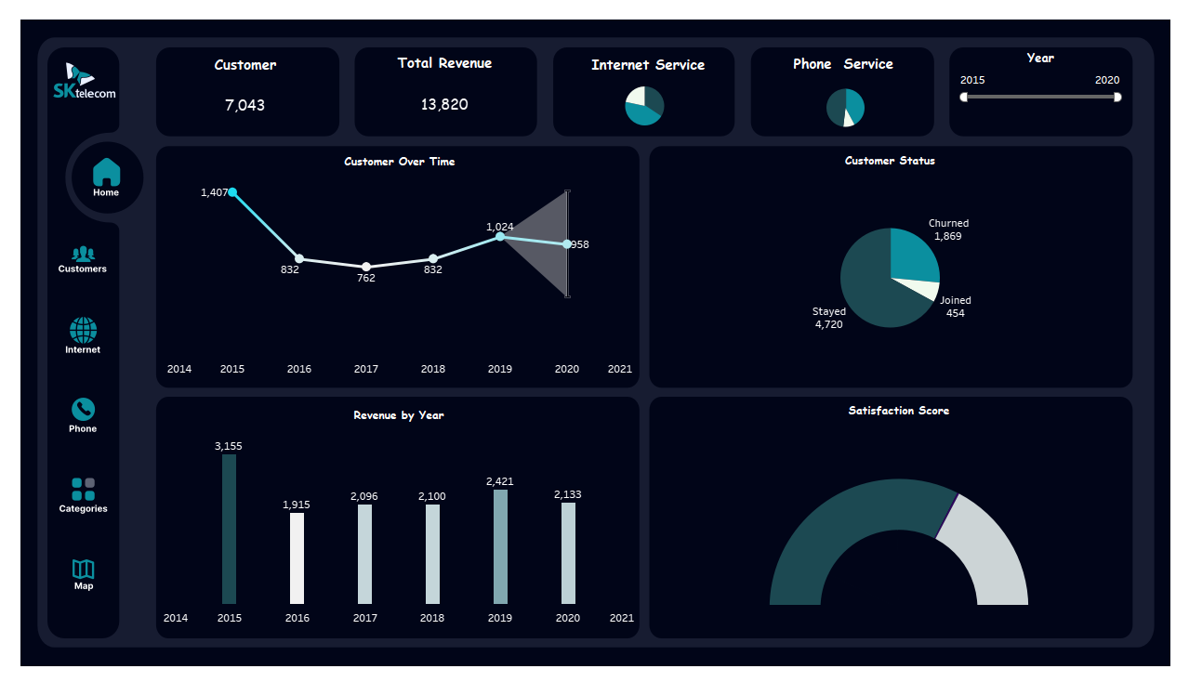
Overview

Slide 38
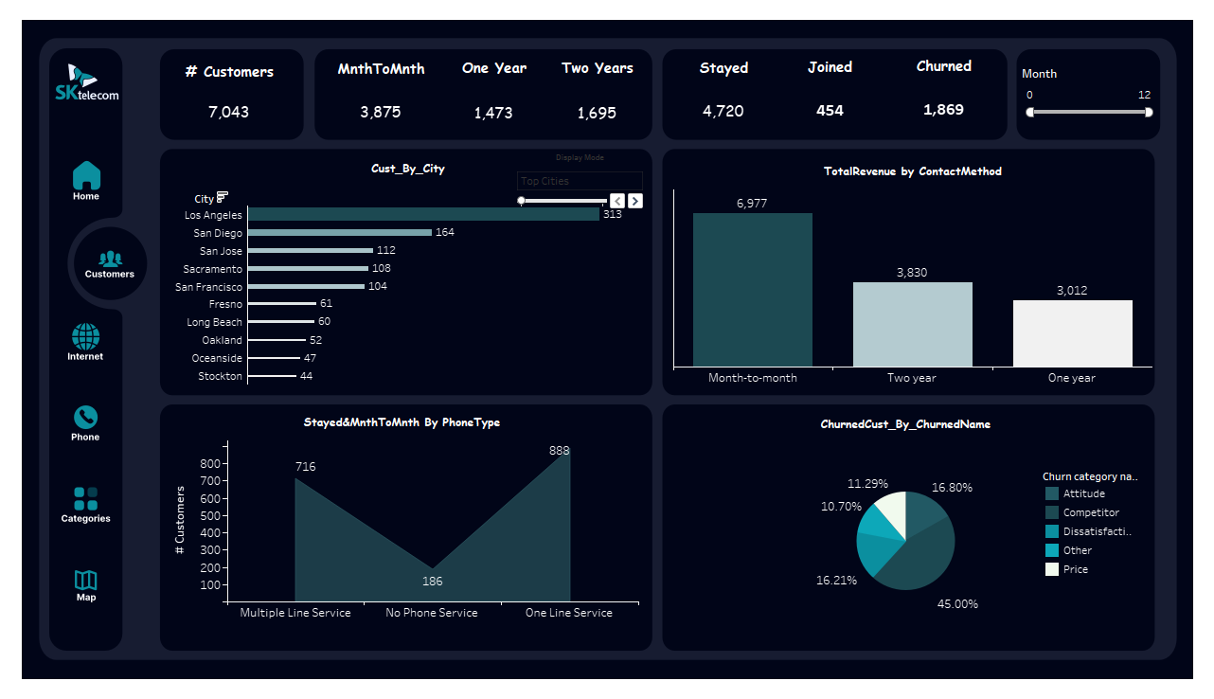
Customer

Slide 39
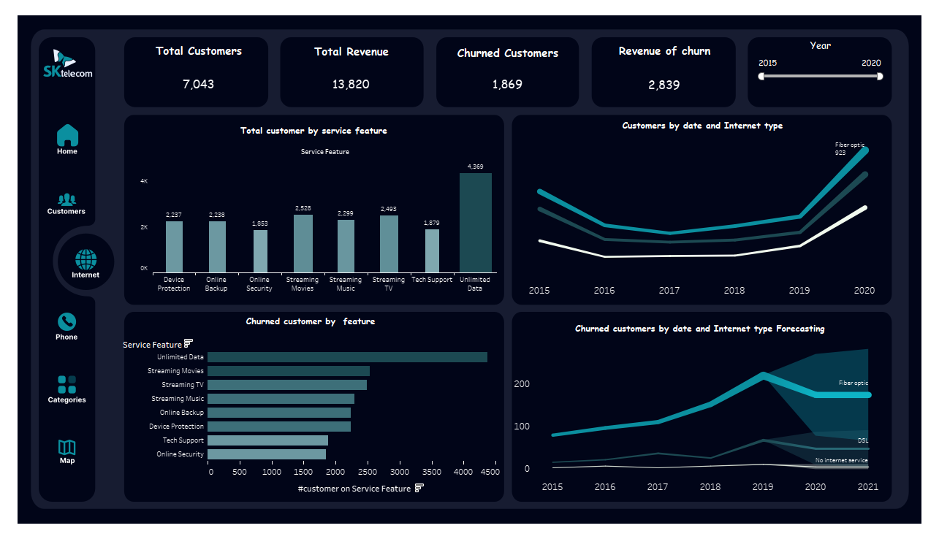
Internet Service

Slide 40
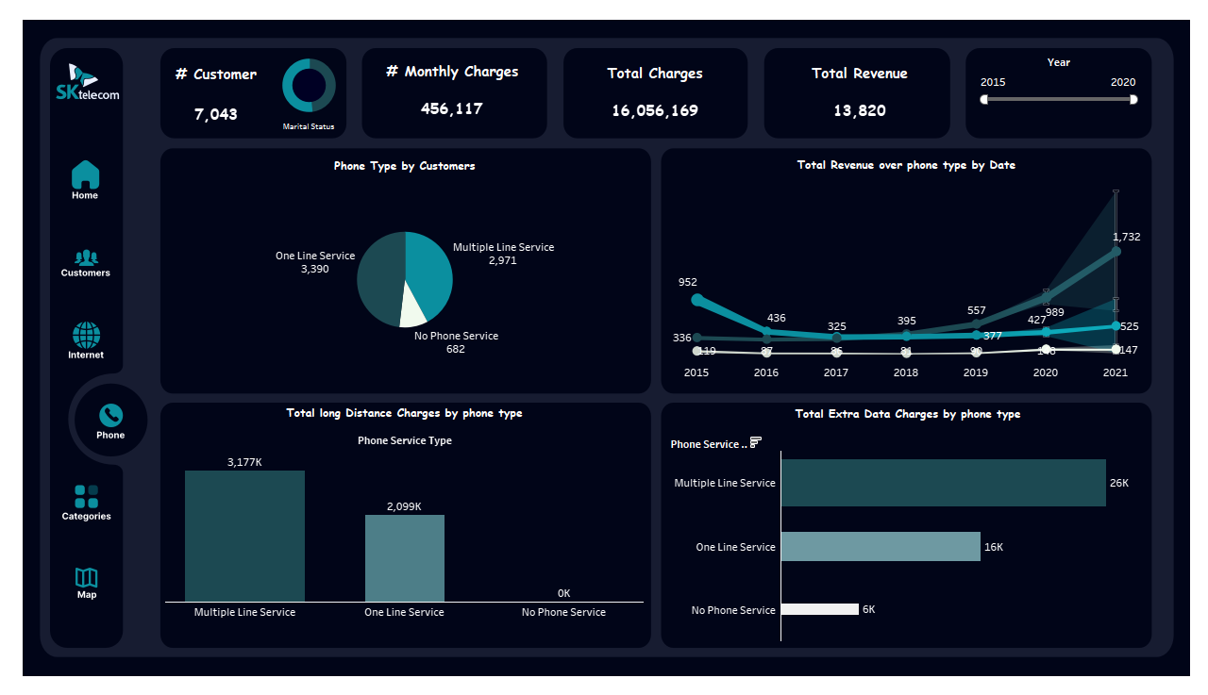
Phone Service

Slide 41
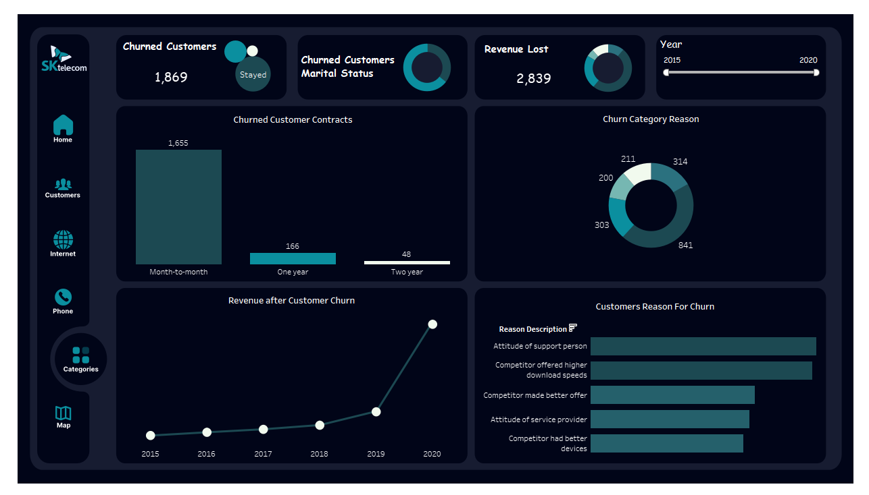
Category

Slide 42
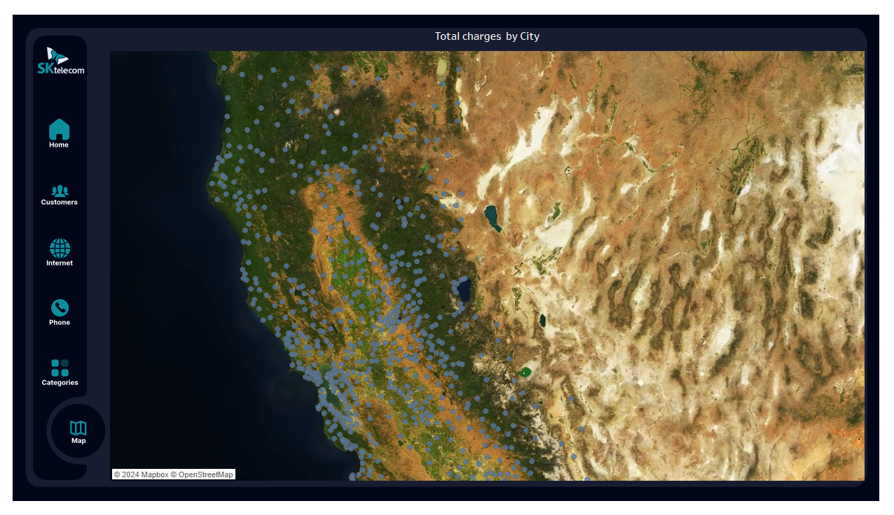
Map

Slide 43

Excel Analysis

Slide 44
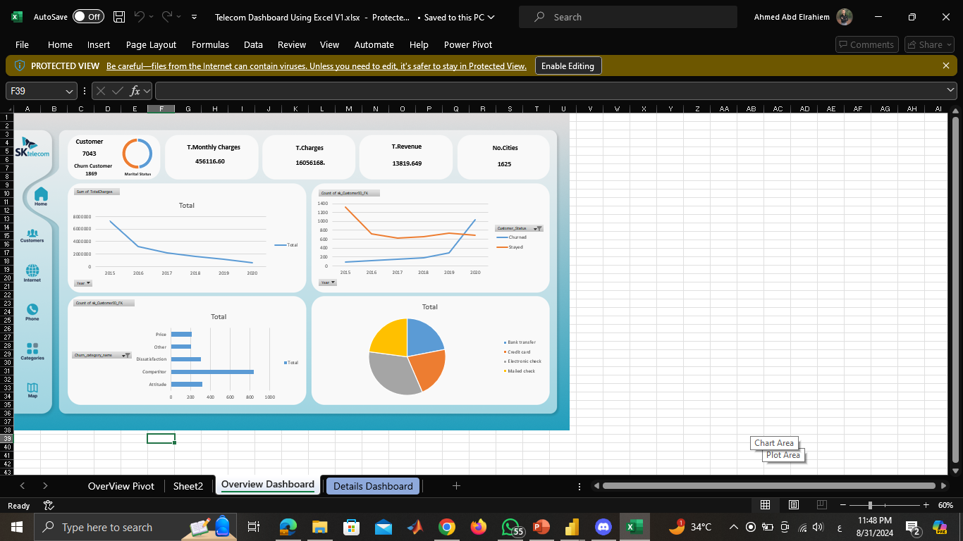
Excel Dashboards

Slide 45






Our Project got through
Select Data Set
Create Database
Create DWH
Telecom_Churn from Kaggle
Design ERD & tables and Transform dataset from Excel to database with SSIS
Design Data warehouse
with star Schema and Transform database to DWH with SSIS
Data Analysis
Data Cleaning & Transformation
Visualization
Analysis data with SSAS create cubes and generate Reports with SSRS
analyze data in multiple ways:- Using Power BI, Tableau and Excel
Cleaning data in power query Load transformation

Slide 46



Thank You

